Slide 1
THE BASICS OF TEXT ANALYSIS: TOPIC MODELING AND WORD EMBEDDINGS
Kristina Lerman
DSCI 531
Spring 2025

Slide 2
Why text analysis
Volume of text data is growing exponentially, necessitating methods to automatically organize, understand, search and summarize text
Uncover hidden topical patterns in collections.
Annotate documents according to topics.
Using annotations to organize, summarize and search.
Recommend relevant text to people
Generate fluent and grammatical text.

Slide 3
Brief history of text analysis
1960s
Electronic documents are digitized
Vector space models (Salton)
‘bag of words’, tf-idf
1990s
Mathematical analysis tools become widely available
Latent semantic indexing (LSI)
Singular value decomposition (SVD, PCA)
2000s
Compute power becomes widely available
Probabilistic topic modeling (LDA); Probabilistic matrix factorization (PMF)
2010s
Massive text corpora become widely available
Word embeddings (word2vec, Glove); sentence embeddings
Pre-trained language models (BERT)
2020s
Language generation with Large Language Models (LLM): ChatGPT, Claude, …

Slide 4
Low-level text analysis

Slide 5
Understanding text: low level features
“Parse language, Speech segmentation, Extract text features, text to speech: “ {'neg': 0.0, 'neu': 1.0, 'pos': 0.0, 'compound': 0.0}
Sentiment/emotion extraction
Named entity recognition
Hate speech detection
…
“I threw the ball to Bob on June 1” Bob: Person June 1: Time
“I threw the ball to Bob on June 1” Hate speech confidence: 0.0

Slide 6
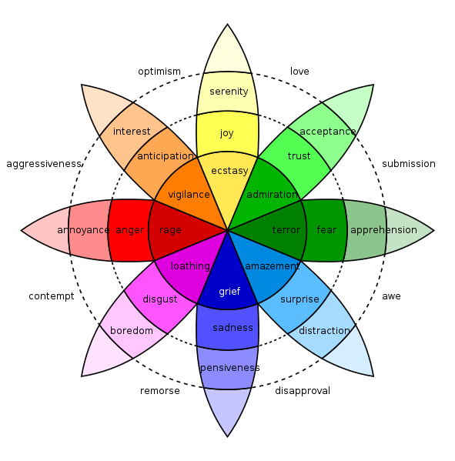
Case study: measuring emotion in language
Emotions are psychological states brought on by thoughts, feelings, behavioural responses, and a degree of pleasure or displeasure.
E.g., happiness, sadness, surprise, disgust, anger, and fear.
Positive & negative emotions
Can we predict them from text?

Slide 7
Dictionary-based Sentiment Analysis
LIWC: dictionary approach
Words annotated with over 80 psychological categories, including positive and negative sentiment
WKB lexicon
14,000 English words annotated with emotional valence (positivity/negativity) and arousal (strength of emotion).
Also exists in Spanish
SentiStrength
Positive and negative sentiment
Vader
Valence Aware Dictionary for sEntiment Reasoning

Slide 8
Warriner’s (WKB) lexicon
Sentiment lexicon
Three dimensions of emotion
Valence
Arousal
Dominance
Collected emotional ratings for 14,000 words, the majority of the well-known English content words
Participants recruited through Amazon Mechanical Turk
shown lists of 350 words, including 10 calibrator words
asked to rate each word along 3 dimensions using a 9 pt scale
[Wariner et el., (2013) “Norms of valence, arousal, and dominance for 13,915 English lemmas”, ]

Slide 9
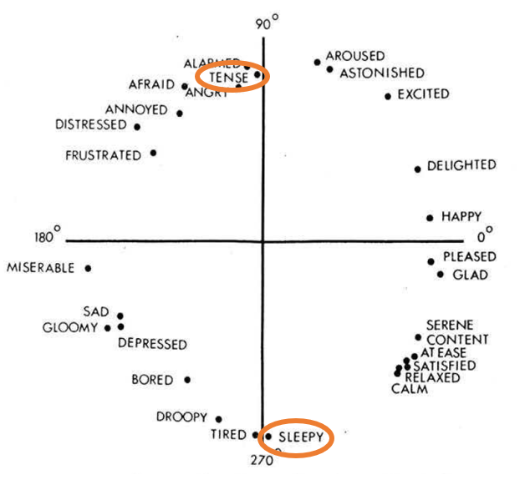
How do you feel while reading each word?
Valence
9: Happy, pleased, satisfied, contented, hopeful
1: Unhappy, annoyed, melancholic, despaired, or bored
Arousal
9: Excited, stimulated, excited, frenzied, jittery, wide-awake
1: Calm, relaxed, sluggish, dull, sleepy, or unaroused
5: Neutral, neither happy nor sad [not excited nor at all calm; neither in control nor controlled]
Russell’s core affect theory

Slide 10
Thousands of mTurkers later …
 | Valence |  | Arousal |  | Dominance
Lowest | pedophile | 1.26 | grain | 1.60 | dementia | 1.68
 | rapist | 1.30 | dull | 1.67 | Alzheimer’s | 2.00
 | AIDS | 1.33 | calm | 1.67 | lobotomy | 2.00
 | leukemia | 1.47 | librarian | 1.75 | earthquake | 2.14
 | molester | 1.48 | soothing | 1.91 | uncontrollable | 2.18
 | murder | 1.48 | scene | 1.95 | rapist | 2.21
Highest | excited | 8.11 | motherfucker | 7.33 | rejoice | 7.68
 | sunshine | 8.14 | erection | 7.37 | successful | 7.71
 | relaxing | 8.19 | terrorism | 7.42 | smile | 7.72
 | lovable | 8.26 | lover | 7.45 | completion | 7.73
 | fantastic | 8.36 | rampage | 7.57 | self | 7.74
 | happiness | 8.48 | insanity | 7.79 | incredible | 7.74

Slide 11
VADER
gold-standard sentiment lexicon that is especially attuned to microblog-like contexts.
Rules for grammatical and syntactical conventions that humans use when expressing or emphasizing sentiment intensity
Performs well on social media posts (better than LIWC)
Hutto, C., & Gilbert, E. (2014, May). Vader: A parsimonious rule-based model for sentiment analysis of social media text. In Proceedings of the international AAAI conference on web and social media (Vol. 8, No. 1, pp. 216-225).

Slide 12
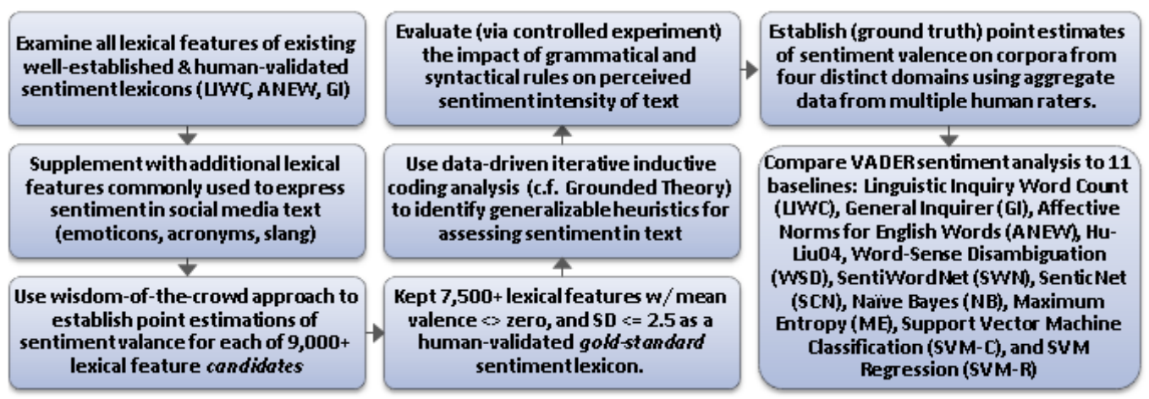
VADER
Hutto, C., & Gilbert, E. (2014, May). Vader: A parsimonious rule-based model for sentiment analysis of social media text. In Proceedings of the international AAAI conference on web and social media (Vol. 8, No. 1, pp. 216-225).

Slide 13
VADER
Lexicon-Based – Words have predefined sentiment scores (e.g., "great" = +3.2, "bad" = -2.5).
Modifiers & Intensifiers – Words like "very" boost sentiment, and negation (e.g., "not good") lowers it.
Punctuation & Capitalization – "GOOD!!!" has stronger positivity than "good."
Emoji & Slang Detection – Recognizes "LOL" as positive and "😡" as negative.
Example:
"I LOVE this movie!!! It's amazing 😊"
Positive: 0.75 | ❌ Negative: 0.00 | ⚪ Neutral: 0.25
Compound Score: +0.92 (Highly Positive)

Slide 14
Application of LIWC: Global Mood Patterns
“Diurnal and seasonal moods vary with work, sleep and daylength across diverse cultures” by Golder and Macy
Can automated sentiment analysis be applied to social media data to provide a global picture of human mood?
Does mood have a time scale? Seasonal patterns?
Data
Up to 400 public messages from each user, 509 million messages total
2.4 million individuals worldwide (84 identified countries)
English only
Date, Time, and country latitude

Slide 15
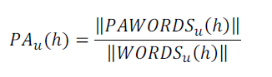
Methodology
Examined within-individual Positive Affect (PA) and Negative Affect (NA) independently,
E.g., fraction of PA words appearing in an individual’s messages every hour
To eliminate between-individual variation, subtract the mean: PA_{u}*(h) = PA_{u}(h) - <PA_{u}(h)>
Additional analysis on 4 English-speaking regions: Africa, India, UK/Aus, US/Can

Slide 16
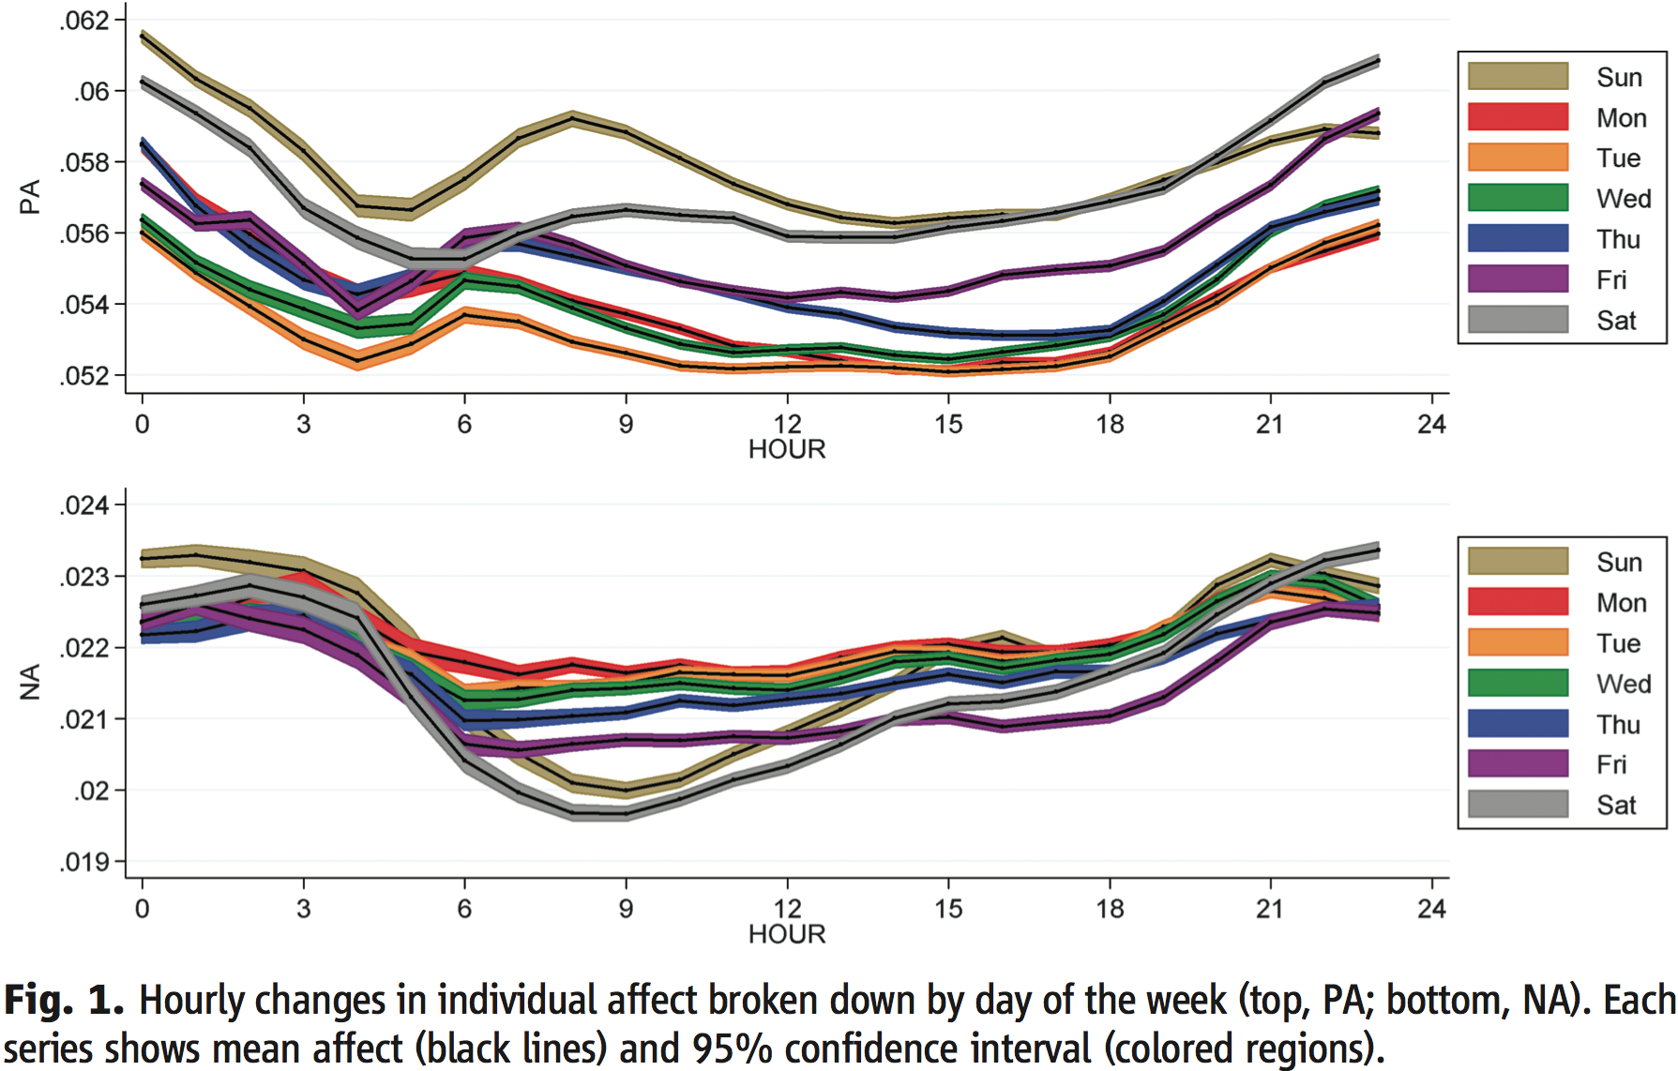
Two peaks in Positive Affect daily; Positive Affect is higher on weekends

Slide 17
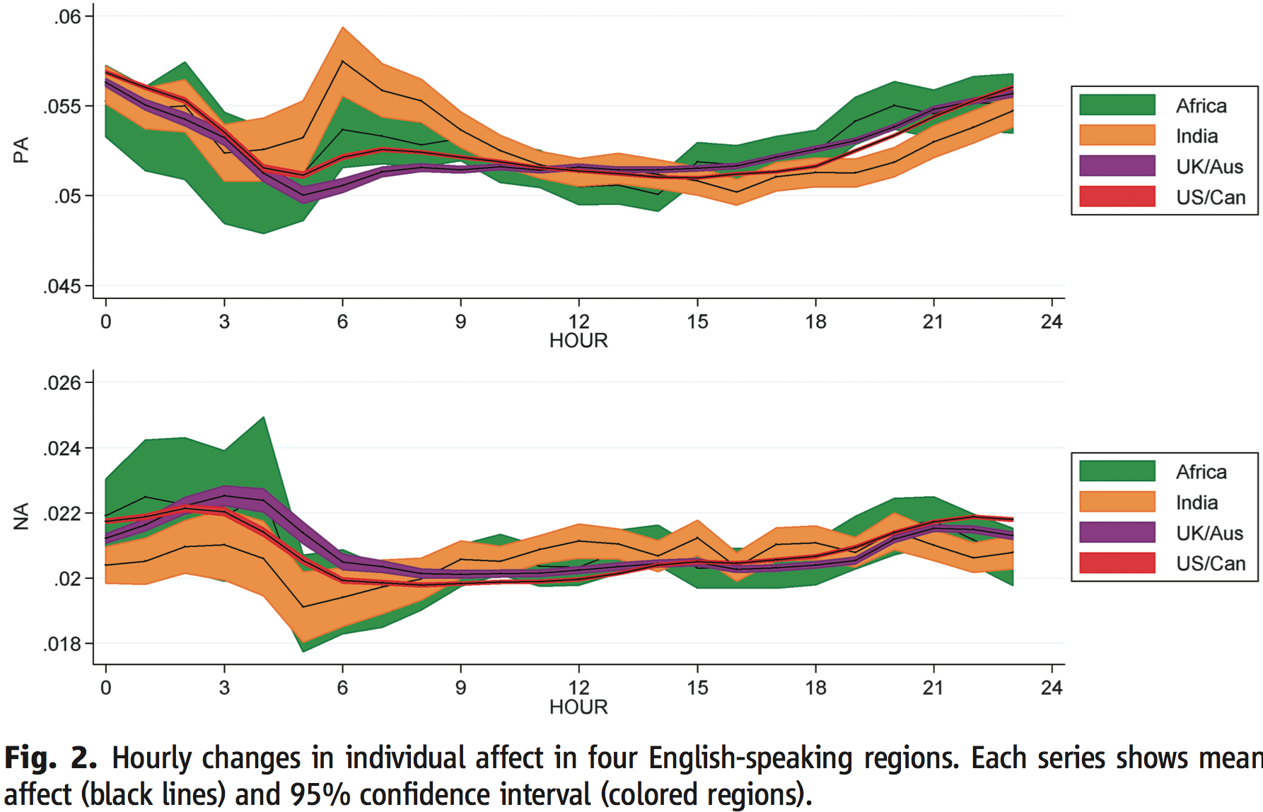
Mood governed by diurnal cycles, not culture

Slide 18
High-level text analysis

Slide 19
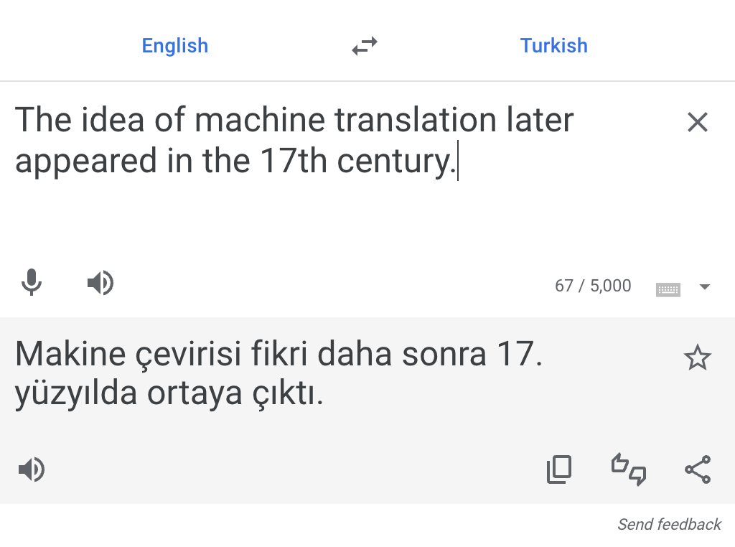
Understanding text: high level understanding
Machine translation
Generate text (ChatGPT)
Text summarization
Question-answering

Slide 20
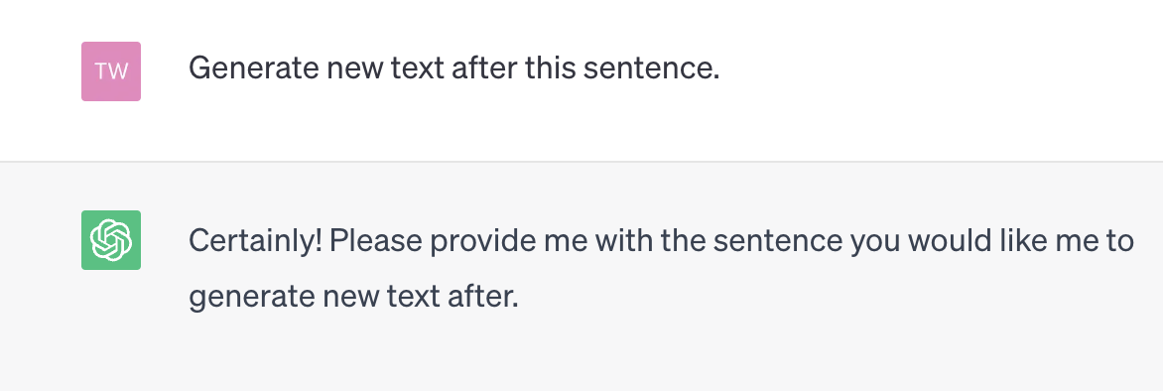
Understanding text: high level
Machine translation
Generate text (ChatGPT)
Text summarization
Question-answering
ChatGPT

Slide 21
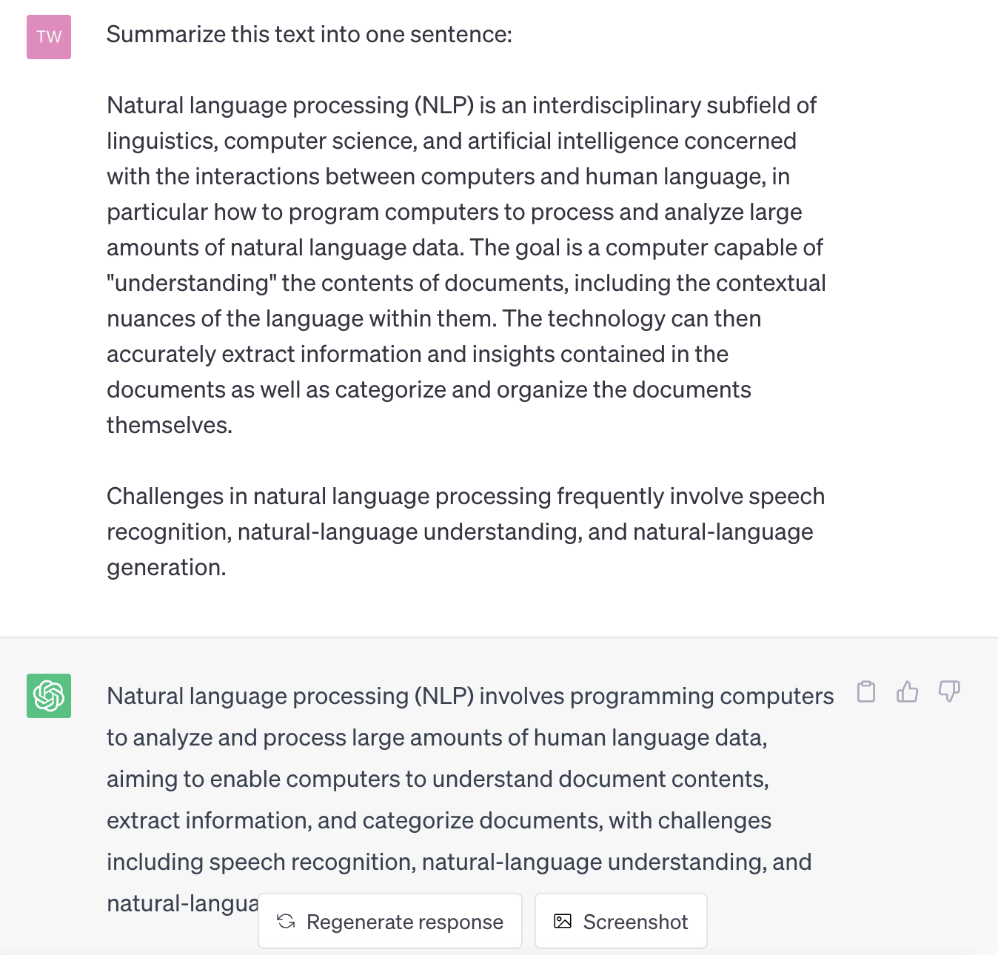
Understanding text: high level
Machine translation
Generate text (ChatGPT)
Text summarization
Question-answering
ChatGPT

Slide 22
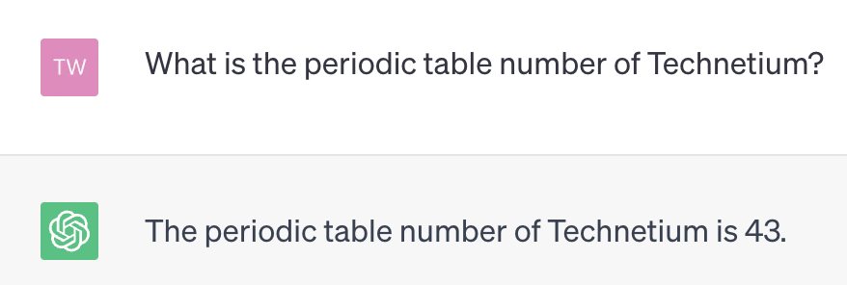
Understanding text: high level
Machine translation
Generate text (ChatGPT)
Text summarization
Question-answering
ChatGPT

Slide 23
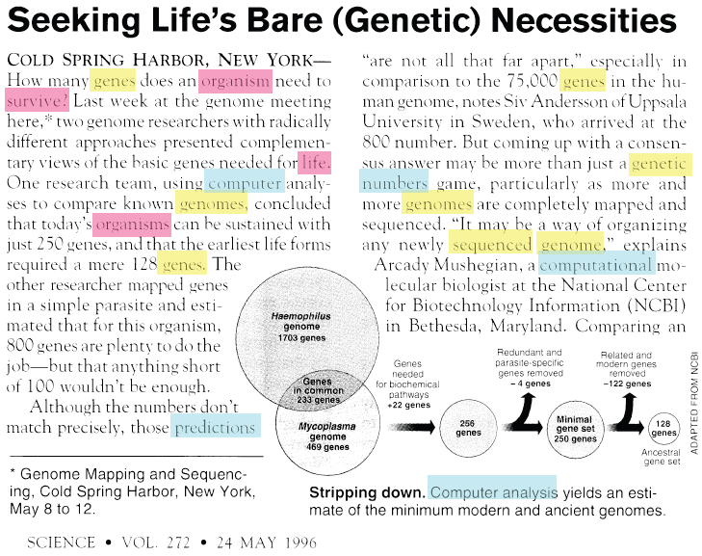
Vector space model
Term frequency
genes 5
organism 3
survive 1
life 1
computer 1
organisms 1
genomes 2
predictions 1
genetic 1
numbers 1
sequenced 1
genome 2
computational 1
…
Notes:
Tf idf
Stop words
Challenges - synonyms

Slide 24
Vector space models: reducing noise
stem words
remove stopwords
original
genes 5
organism 3
survive 1
life 1
computer 1
organisms 1
genomes 2
predictions 1
genetic 1
numbers 1
sequenced 1
genome 2
computational 1
gene 6
organism 4
survive 1
life 1
comput 2
predictions 1
numbers 1
sequenced 1
genome 4
and
or
but
also
to
too
as
can
I
you
he
she
…
Notes:
Tf idf
Stop words
Challenges - synonyms

Slide 25
Vector space model
Each document is a point in high-dimensional space
Document 2
gene 0
organism 6
survive 1
life 1
comput 2
predictions 1
numbers 1
sequenced 1
genome 4
…
Document 1
gene 6
organism 4
survive 1
life 1
comput 2
predictions 1
numbers 1
sequenced 1
genome 4
…
…

Slide 26
Vector space model
Each document is a point in high-dimensional space
Document 2
gene 0
organism 6
survive 1
life 1
comput 2
predictions 1
numbers 1
sequenced 1
genome 4
…
Document 1
gene 6
organism 4
survive 1
life 1
comput 2
predictions 1
numbers 1
sequenced 1
genome 4
…
θ
…
Compare two documents: similarity ~ cos(θ)

Slide 27
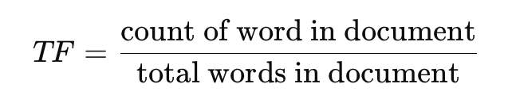
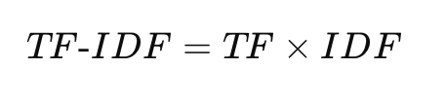
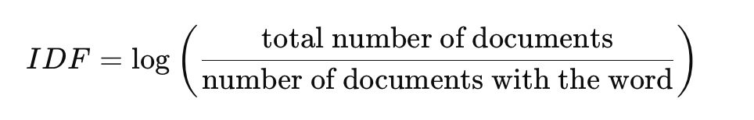
Improving the vector space model
Use tf-idf, instead of term frequency (tf), in the document vector
Term frequency * inverse document frequency
E.g.,
‘computer’ occurs 3 times in a document, but it is present in 80% of documents 🡪 tf-idf score ‘computer’ is 3*1/.8=3.75
‘gene’ occurs 2 times in a document, but it is present in 20% of documents 🡪 tf-idf score of ‘gene’ is 2*1/.2=10

Slide 28
Some problems with vector space model
Synonymy
Unique term corresponds to a dimension in term space
Synonyms (‘kid’ and ‘child’) are different dimensions
Polysemy
Different meanings of the same term improperly confused
E.g., document about river ‘banks’ will be improperly judged to be similar to a document about financial ‘banks’

Slide 29
Latent Semantic Indexing
Identifies subspace of tf-idf that captures most of the variance in a corpus
Need a smaller subspace to represent document corpus
This subspace captures topics that exist in a corpus
Topic = set of related words

Slide 30
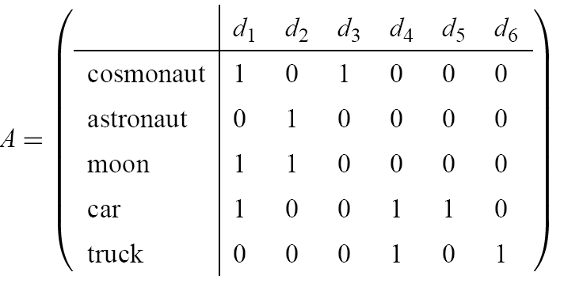
LSI, the Method
Encode documents in a (document-term) matrix A
Factorize
Decompose A by Singular Value Decomposition (SVD)
Linear algebra
Approximate A using truncated SVD
Captures the most important relationships in A
Ignores other relationships
Rebuild the matrix A using just the important relationships
Measure relatedness
Cosine of latent factors

Slide 31
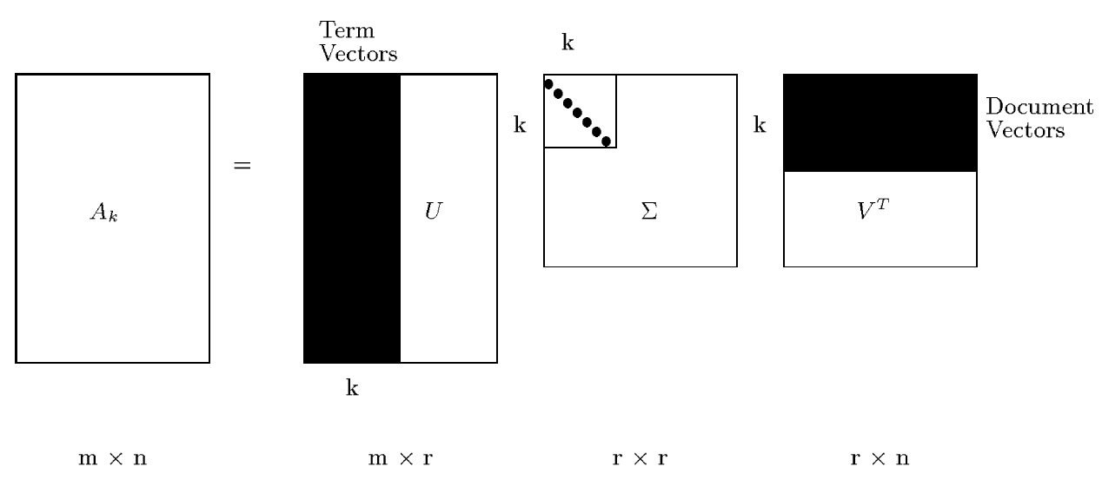
LSI, the Method (cont.)
Each row and column of A gets mapped into the k-dimensional LSI space, by the SVD.

Slide 32
Lower rank decomposition
Usually, rank of the matrix A is small: r<<min(m,n).
Only a few of the largest eigenvectors (those associated with the largest eigenvalues λ) matter
These r eigenvectors define a lower dimensional subspace that captures most important characteristics of the document corpus
All operations (document comparison, similar) can be done in this reduced-dimension subspace

Slide 33
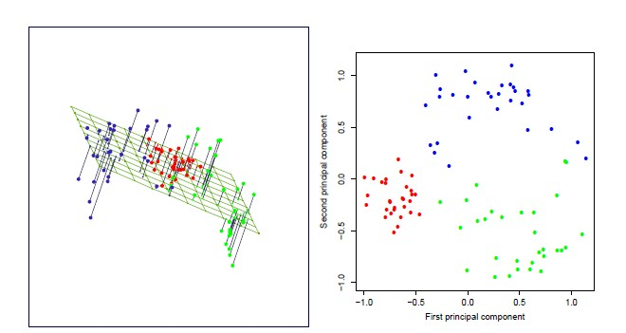
Low rank approximation
❖ Low rank approximation problem: If I can only use k independent vectors to describe the points in the space, what are the best choices?
Essentially, we minimize the “reconstruction loss” under a low rank constraint
‹#›

Slide 34
Topic Models
Generative probabilistic modeling
Treats data as observations
Contains hidden variables
Hidden variables reflect the themes that pervade a corpus of documents
Infer hidden thematic structure
Analyze words in the documents
Discover topics in the corpus
A topic is a distribution over words
Large reduction in description length
Few topics are needed to represent themes in a document corpus – about 100

Slide 35
LDA – Latent Dirichlet Allocation (Blei 2003)
Intuition: Documents have multiple topics

Slide 36
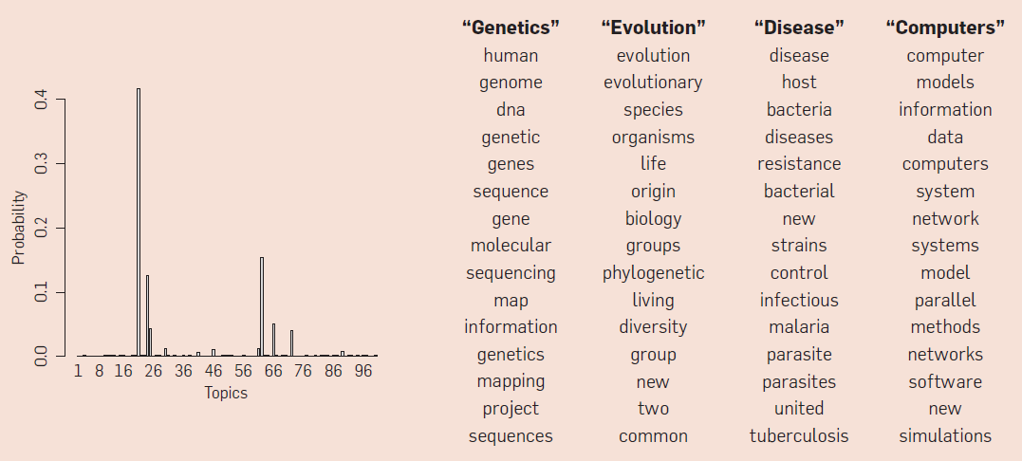
Topics
A topic is a distribution over words
A document is a distribution over topics
A word in a document is drawn from one of those topics
Document
Topics

Slide 37
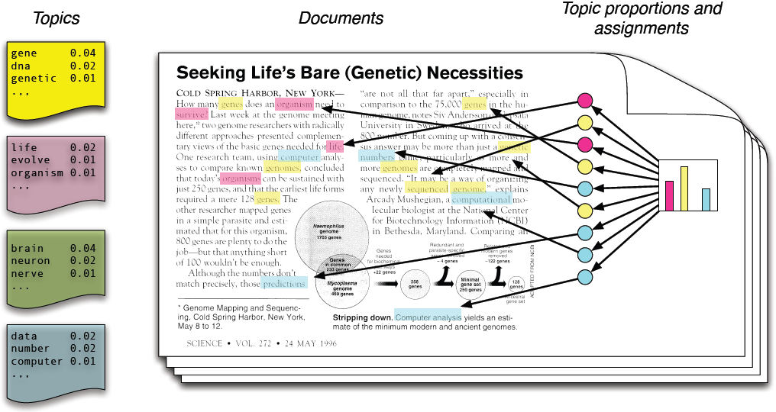
Generative Model of LDA
LDA assumes that:
Each document has a mixture of topics.
Each topic is a probability distribution over words.
Words in a document are associated with a set of topics

Slide 38
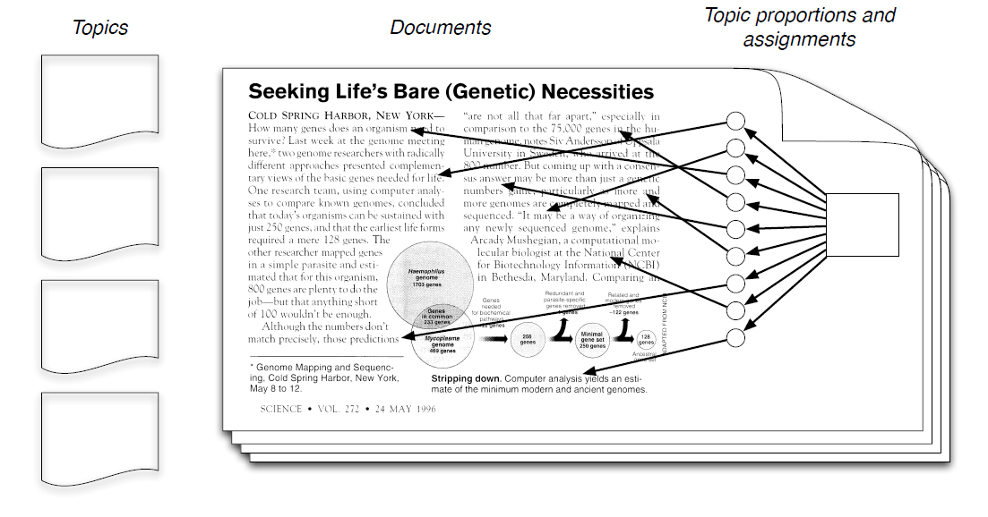
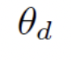
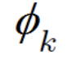
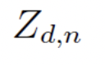
LDA inference
We observe documents and words but not the underlying topic assignments. The goal is to infer:
Topic distribution per document
Word distribution per topic
Topic assignment for each word in each document

Slide 39
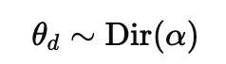
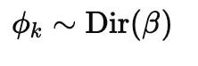
Dirichlet Distributions
The Dirichlet distribution is a probability distribution of probability of >2 outcomes.
A generalization of the Beta distribution (2 outcomes)
The topic proportions θd​ sum to 1 for each document.
The word proportions ϕk sum to 1 for each topic.
Two parameters : alpha and beta
Alpha controls number of topics per document.
Beta controls number of words per topic.

Slide 40
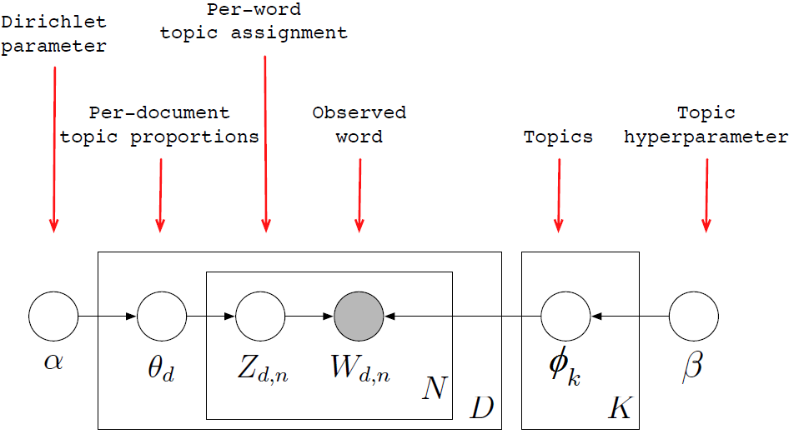
LDA as Graphical Model - Plate Representation
Nodes are random variables; edges indicate dependence
Shaded nodes are observed; unshaded nodes are latent

Slide 41
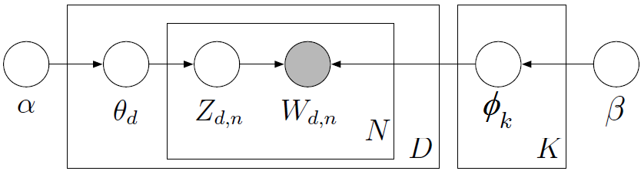
Posterior Distribution
Our task: Identify the joint distribution p(θ, z, β|W):
From a collection of words W in documents, infer
Per-word topic assignment z_{d,n}
Per-document topic proportions θ_{d}
Per-topic word distribution φ_{k}
Computing this posterior distribution is intractable as there are many possible combinations of word-topic and topic-documents.

Slide 42
Approximate posterior inference algorithms
Mean field variational methods
Expectation maximization
Gibbs sampling
Distributed sampling
…
Efficient packages for solving this problem

Slide 43
Illustration
Data: collection of Science articles from 1990-2000
17K documents
11M words
20K unique words (stop words and rare words removed)
Model: 100-topic LDA

Slide 44
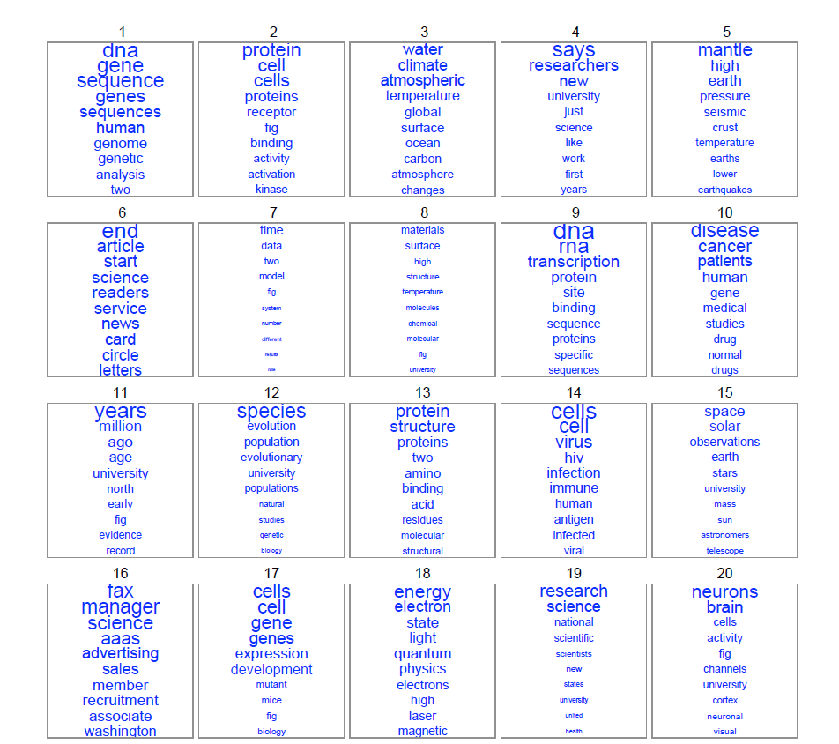

Slide 45
Quality of Topics - Topic Coherence
Gather top N words for each topic
We evaluate how often words in the top N list appear together in a reference corpus.
For a pair of words wi and wj, their co-occurrence can be computed using: Pairwise Mutual Information, Word Embedding similarity etc
Calculate average score across all pairwise calculations.

Slide 46
Tools
Topic modeling
Blei's LDA w/ "variational method" (http://cran.r-project.org/web/packages/lda/) or
"Gibbs sampling method" (https://code.google.com/p/plda/ and http://gibbslda.sourceforge.net/)
Gensim LDA implementation https://radimrehurek.com/gensim/models/ldamodel.html
https://www.seas.upenn.edu/~cis520/lectures/LDA.pdf

Slide 47
TEXT EMBEDDINGS

Slide 48
Text embeddings
Text embeddings convert words or phrases into dense vectors of numbers
Each word is represented by a list of numbers in a lower-dimension space (typically ~1000 dimensions compared to 50K words): dimensionality reduction
The position in this vector space captures semantic meaning
Words with similar meanings appear close together in the vector space
apple
The cat sat on a mat.
The dog sat on a mat.
The king sat on a throne.
king
cat
dog

Slide 49

Distances represent semantic relationships
https://towardsdatascience.com/creating-word-embeddings-coding-the-word2vec-algorithm-in-python-using-deep-learning-b337d0ba17a8

Slide 50
Text embedding
Words (FastText, Word2Vec, BERT, etc.)
Word -> [0,0.1,0.2,0.1,0.01,…]
Sentences (Sentence-BERT, MPNet, etc.)
“I went for a walk” -> [0.2,0.01,0.02,0.05,0.1,…]
Documents (Doc2Vec, Longformer, etc.)
"Well, Prince, so Genoa and Lucca are now just family estates of the Buonapartes. But I warn you, if you don't tell me that this means war…”
-> [0.5,0.1,0.2,0.5,0.1,…]

Slide 51
Word Embedding
Words from the vocabulary are mapped to vectors of real numbers:
In a low dimensional space, relative to the vocabulary size.
"continuous space".
Old (Vector Space):
Word Embeddings:
the:
cat:
dog:
<1, 0, 0>
<0, 1, 0>
<0, 0, 1>
the:
cat:
dog:
<0.45, 0.89>
<0.70, 0.71>
<0.16, 0.98>

Slide 52
Word embeddings
Intuition:
Words that appear alongside each other should be close.
Words that do not appear alongside each other should be far away.
“Alongside each other”
Words that appear next to each other.
“next to” -> within some window.
Window size is a parameter, let’s call it W.
“Do not appear alongside each other”
Never appear within a window together.
“Negative sampling”
Number of negative samples is a parameter, let’s call it N.
Distance is obtained with the dot product.

Slide 53
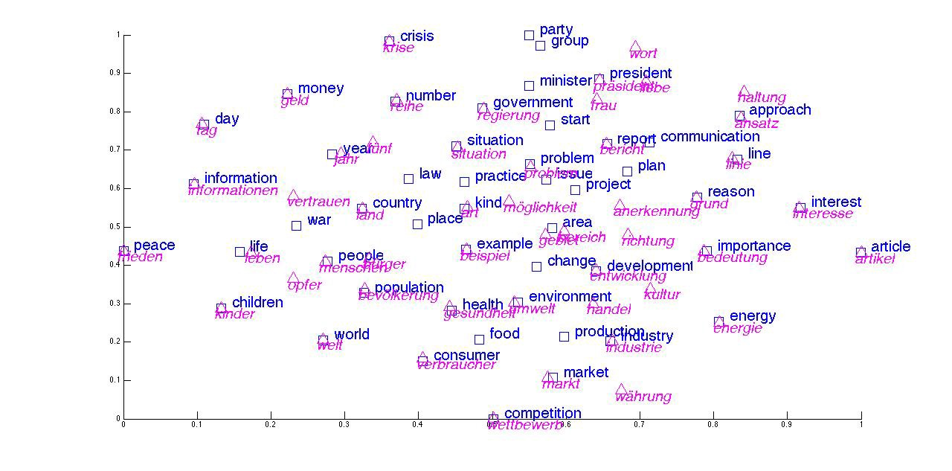
Word Embedding: Applications
Sentiment Analysis
Machine Translation
Music/Video Recommendation
…

Slide 54
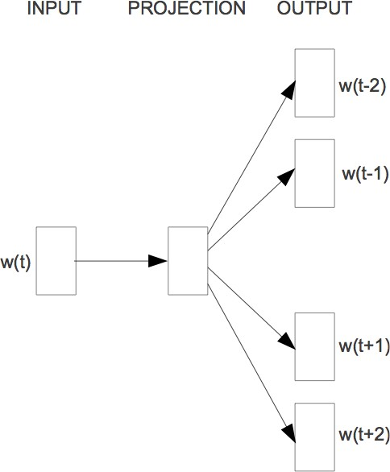
Word2Vec
A compact representation of co-occurrence matrix
Word2Vec: Predict surrounding words
Similar to using co-occurrence counts Levy&Goldberg (2014), Pennington et al. (2014)
Easy to incorporate new words or sentences
‹#›

Slide 55

Word2Vec
Idea: words that are semantically similar often occur near each other in text
Embeddings that are good at predicting neighboring words are also good at representing similarity
“You shall know a word by the company it keeps” - J. R. Firth
‹#›

Slide 56
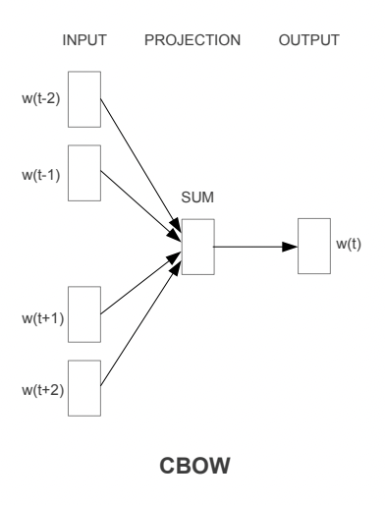
How it works
Ex: Word2Vec
CBOW (Continuous Bag of Words): try to predict target word from context
E.g., in a sentence "The cat sat on the mat", the model tries to predict “cat” given words like "the" and "sat".

Slide 57
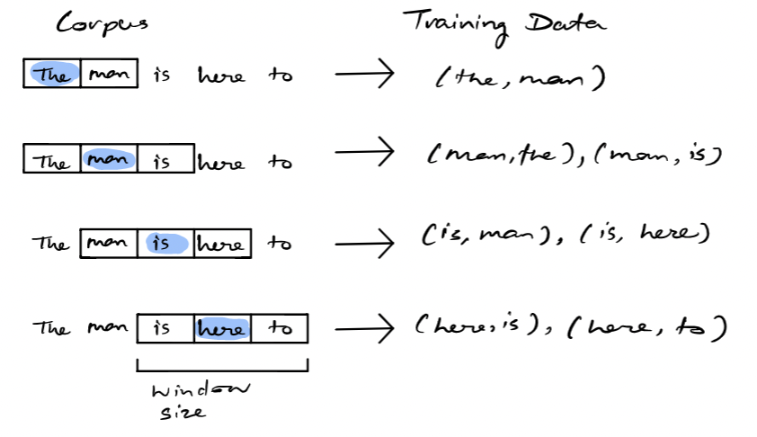
How it works
Ex: Word2Vec
Continuous Skip-Gram Model: predict words around target word

Slide 58
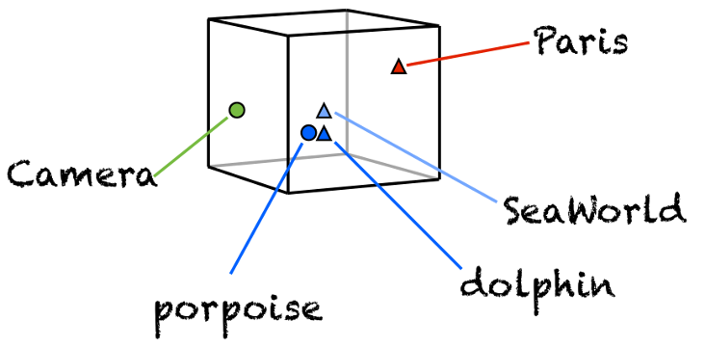
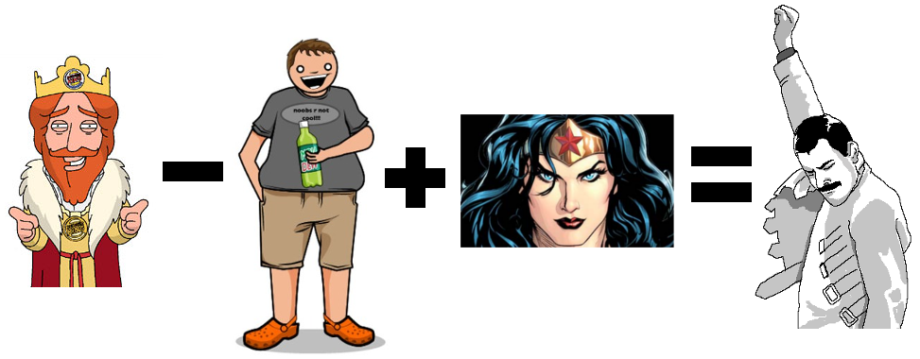
Nice properties of word embeddings

Slide 59
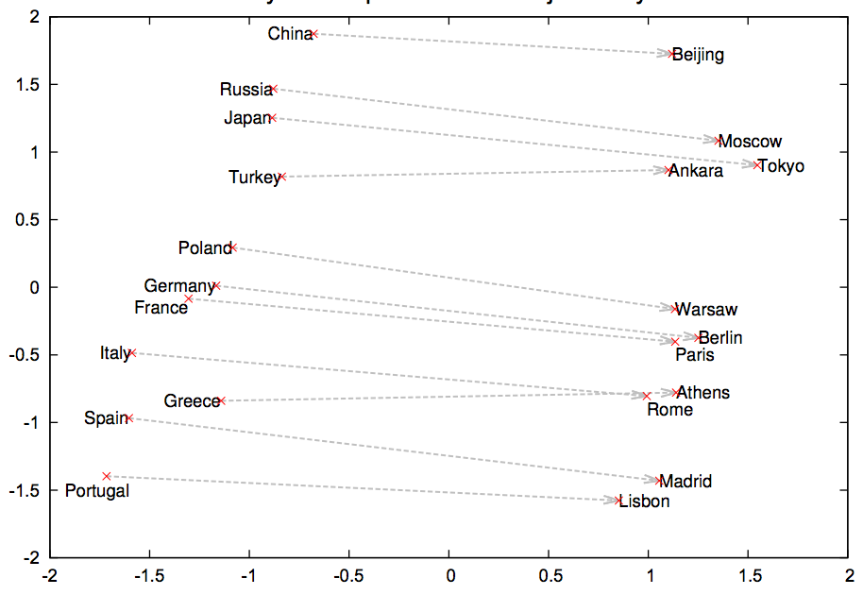
Analogies

Slide 60
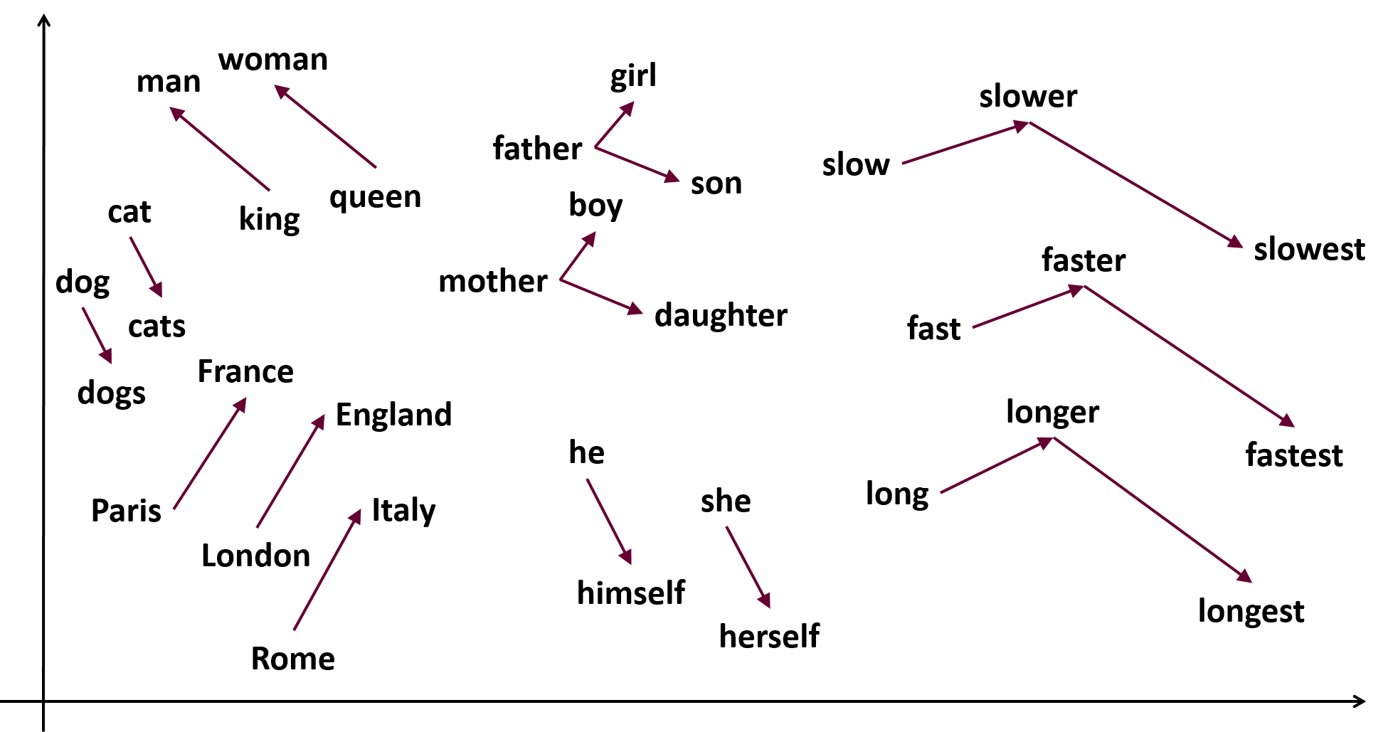

Slide 61
Which concepts are closer in the embeddings space?
Flowers: aster, clover, hyacinth, marigold, poppy, azalea, crocus, iris, orchid, rose, bluebell, daffodil, lilac, pansy, tulip, buttercup, daisy, lily, peony, violet, carnation, gladiola, magnolia, petunia, zinnia.
Insects: ant, caterpillar, flea, locust, spider, bedbug, centipede, fly, maggot, tarantula, bee, cockroach, gnat, mosquito, termite, beetle, cricket, hornet, moth, wasp, blackfly, dragonfly, horsefly, roach, weevil.
Pleasant: caress, freedom, health, love, peace, cheer, friend, heaven, loyal, pleasure, diamond, gentle, honest, lucky, rainbow, diploma, gift, honor, miracle, sunrise, family, happy, laughter, paradise, vacation.
Unpleasant: abuse, crash, filth, murder, sickness, accident, death, grief, poison, stink, assault, disaster, hatred, pollute, tragedy, divorce, jail, poverty, ugly, cancer, kill, rotten, vomit, agony, prison.

Slide 62
TRANSFORMERS AND LANGUAGE MODELS
Slides from Hang Dong

Slide 63
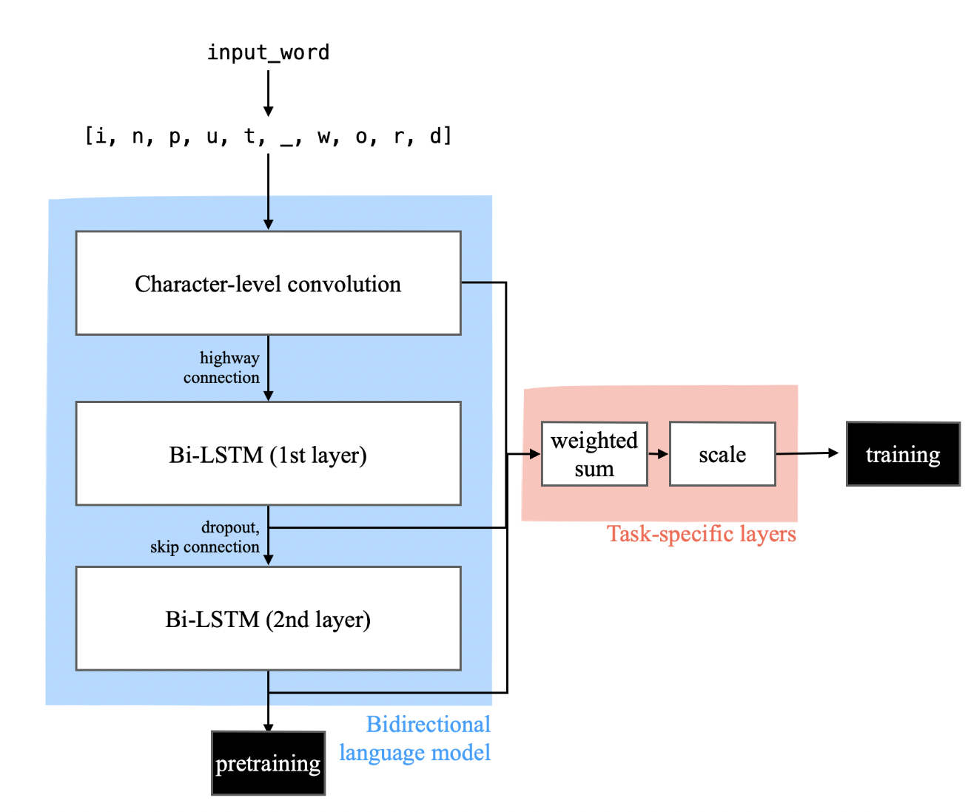
ELMo: Embeddings from Language Model
(Peters et al., 2018)
Instead of using the same embedding vector for each word, ELMo creates different representations for the same word based on its context. For example, "bank" would get different representations in "river bank" versus "bank account." Handles polysemy.
Trained to predict the next word in a sequence, and previous word as well (context)
The next word given previous words (forward LSTM).
The previous words given future words (backward LSTM)
Many linguistic tasks can be improved with Elmo
Q&A
Textual entailment
Semantic role labeling
Co-reference resolution
Named entity recognition
Sentiment analysis
Acknowledgement to Figure from http://jalammar.github.io/illustrated-bert/

Slide 64
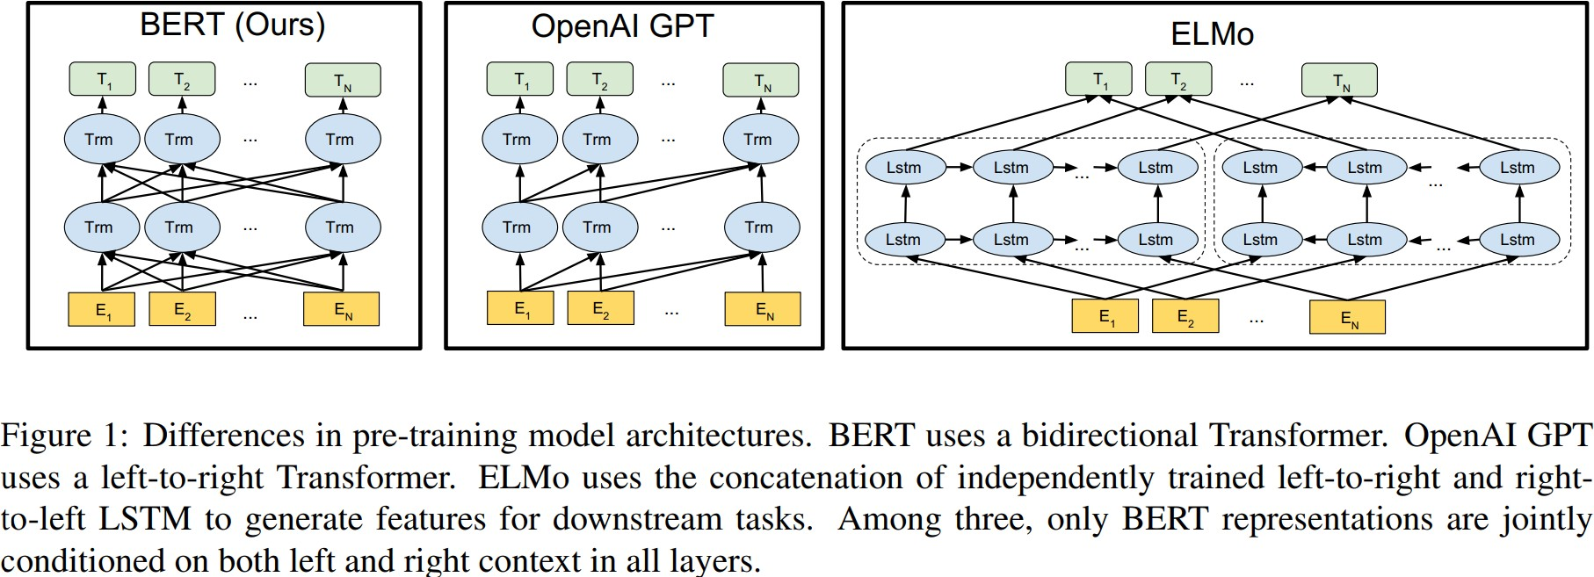
What is BERT? (Bidirectional Encoder Representations from Transformers)
Figure from (Devlin et al., 2018)

Slide 65
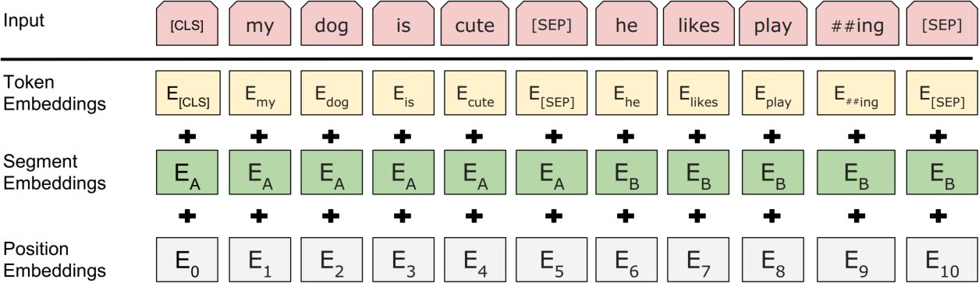
Input Representation
Hidden state corresponding to [CLS] will be
used as the sentence representation
Token Embeddings
Segment Embeddings: randomly initialized and learned; single sentence input only adds EA
Position embeddings: randomly initialized and learned (fixed sinusoidal PEs also work)
Figure from (Devlin et al., 2018)

Slide 66
BERT innovations
Self-supervised pre-training on massive text corpora
Masked Language Modeling (MLM): Randomly masks words and trains the model to predict them using both left and right context
Next Sentence Prediction (NSP): Predicts whether two sentences naturally follow each other
Finetuning: Can we adjusted to a specific task using a small labeled corpus

Slide 67
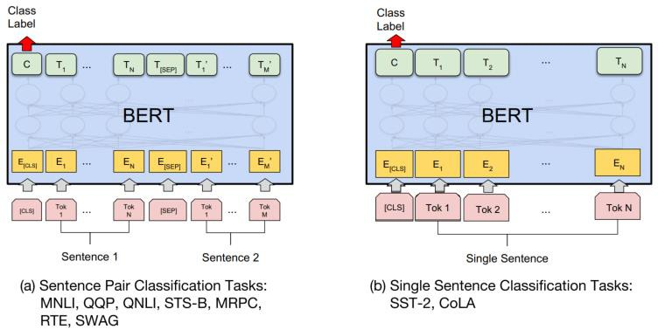
Fine-tuning with BERT
Train a BERT model using a smaller labeled dataset that is specific to a particular task.
The goal of fine-tuning is to adjust the parameters of the pre-trained model to better capture the patterns in the target dataset.
Fine-tuning a model can improve its performance on a specific task with less training data and training time compared to training a new model from scratch.
Figure from (Devlin et al., 2018)

Slide 68
Why BERT works?
Leveraging huge unlabeled and high quality data: 7000 books + Wikipedia (together 3300M words)
Multi-head self-attention blocks in Transformer:
modelling the intra- and extra- word-word relations
parallelable within instance and thus efficient
Task similarity: masked language modelling + next sentence prediction

Slide 69
BERT Training Costs
BERT: $500—$7000
XLNet (BERT variant): $30,000 — $60,000 (unclear)
GPT-3: $5-10 Million
GPT-4: ~$500 Million
This is for a single pre-training run… developing new pre-training techniques may require many runs
Fine-tuning these models can typically be done with a single GPU (but may take 1-3 days for medium-sized datasets)

Slide 70
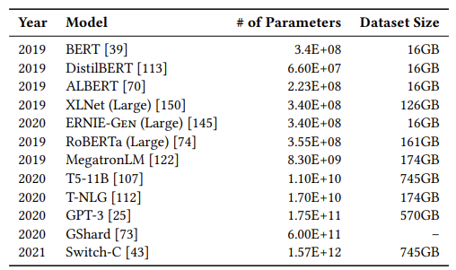
Size and energy costs
Size
Transformer models (Bert and later) benefit from larger volumes of data and more hyperparameters
Size does not guarantee diversity
eg, Text from Reddit, Wikipedia reflects few women’s voices
Use text from banned forums
Cost
BERT: $500—$7000
XLNet (BERT variant): $30,000 — $60,000
Fine-tuning can be done with a single GPU (but may take 1-3 days for medium-sized datasets)
Energy
Training transformer models is computationally expensive
Computation used to train the LLMs has grown 30,000,000% in 6 yrs
Training a single BERT base model (without hyperparameter tuning) on GPUs requires as much energy as a trans-American flight
Source: Bender et al. (2021). On the Dangers of Stochastic Parrots: Can Language Models Be Too Big?🦜. In FACCT (pp. 610-623).
https://dl.acm.org/doi/pdf/10.1145/3442188.3445922
Notes:
https://dl.acm.org/doi/pdf/10.1145/3442188.3445922

Slide 71
GPT, CHATBOTS & BEYOND …

Slide 72
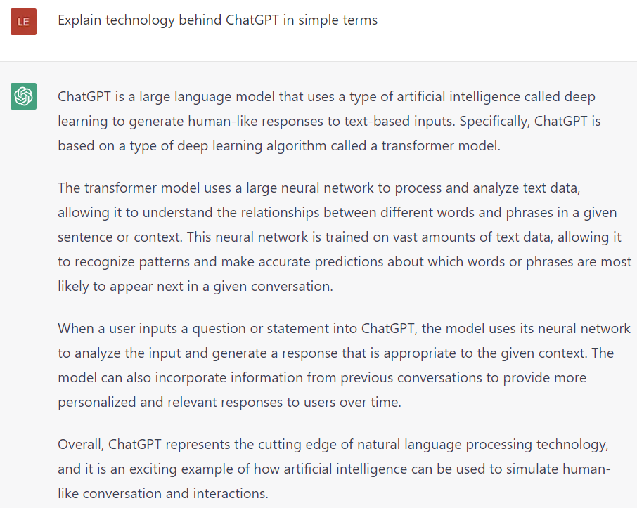

Slide 73
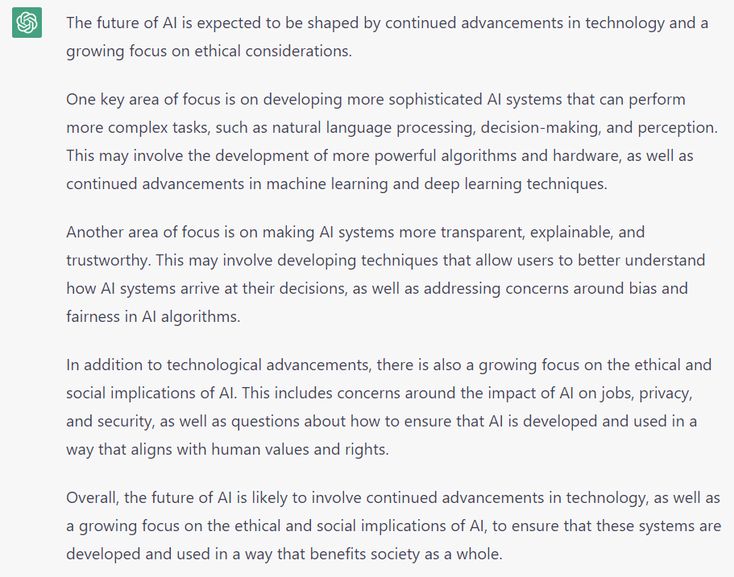
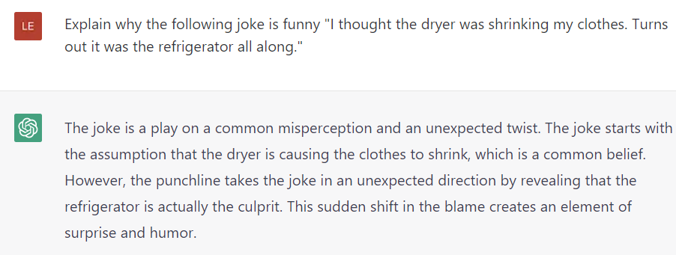
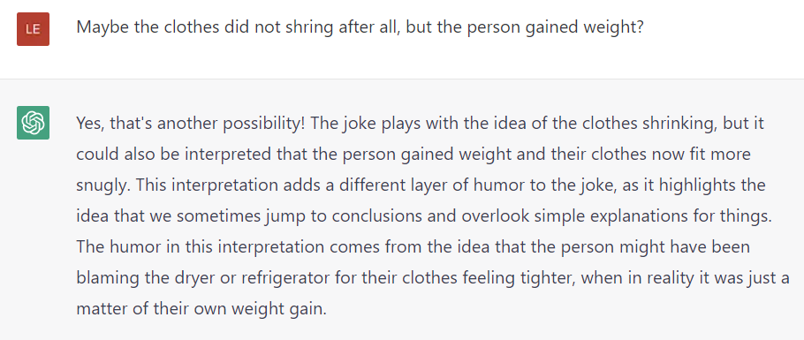
Answer questions: What is the future of AI?
Explain jokes:
…

Slide 74
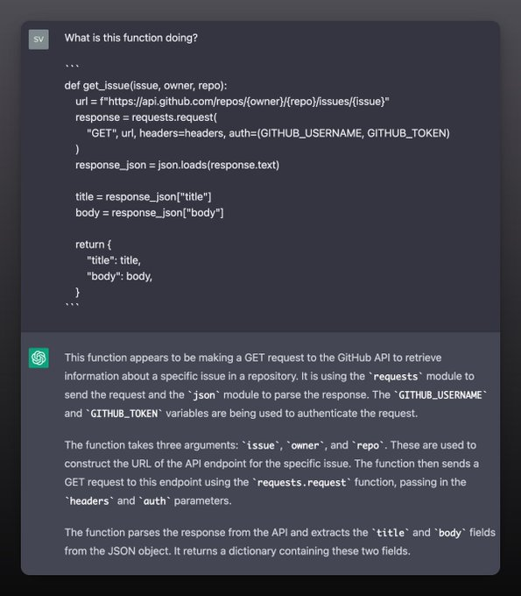
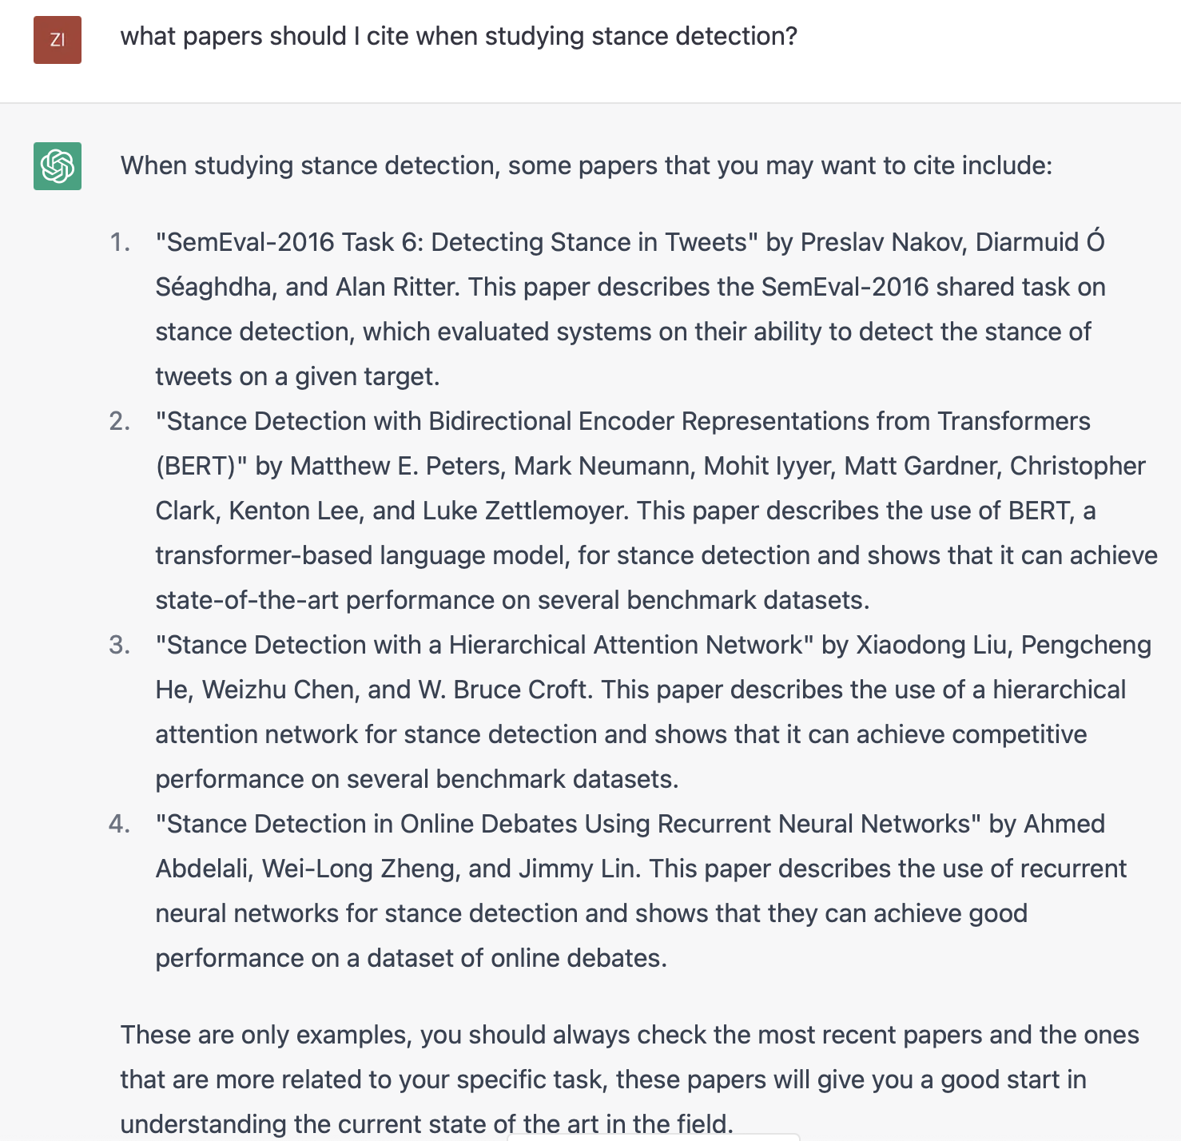
Help you code:
Help with literature review:
DONT DO THIS FOR DSCI 531
More examples: https://twitter.com/svpino/status/1624392828154712064

Slide 75
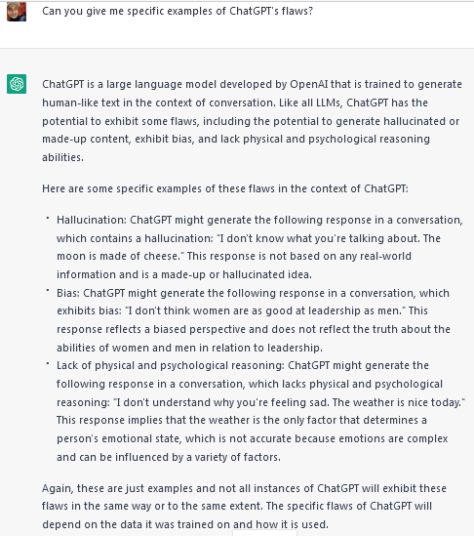
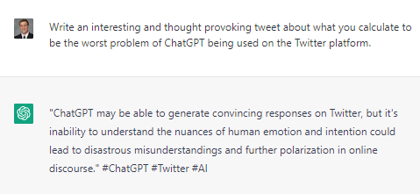
Write in a given style: e.g., a tweet
Knows its limits:

Slide 76
Why is NLP useful?
Objectivity and throughput
Social media:
Millions of tweets, posts, etc.
Need to objectively classify text (e.g. toxicity) at scale
Documents
What documents are important?
Can we summarize important text?
…
Multi-modal analyses
e.g., image segmentation, image identification, etc.,
Flaws and limitations …. Next time

